Slide 1
What to do in the event of an earthquake
Prof A D Redmond

Slide 2
https://www.paho.org/disasters/index.php?option=com_content&view=article&id=3611:what-to-do-before-during-and-after-and-earthquake&Itemid=1289&lang=en
Notes:
This is a very good website that has much of the information you need.

Slide 3
Always
Register with your embassy
Have important documents near you
Keep a Torch
Know your escape routes
Notes:
There are some simple things to do that will help you should an emergency arise. Registering with your embassy means they would know you are in the country and will be a point of contact for your family and for you.
I always keep my important documents such as passport and credit cards on me at all times. Obviously don’t have them visible to pickpockets. There are some very good belt wallets that you can wear close to you and have these by your bed when you are sleeping.
Have a copy of your passport number to help with renewal/temporary document if yours is lost or damaged.. I have a photograph of my passport on my phone.
If your phone doesn’t have a torch then always carry a small torch. I do anyway in case my phone battery runs out. Also carry a portable charger/powerpack. When the lights go out it is very disconcerting and a torch can be extremely helpful in getting you to safety.
In earthquake prone countries they usually have guidelines on what to do if there is an earthquake and all hotels and accommodation should have emergency escape routes displayed in your room. Read them!

Slide 4
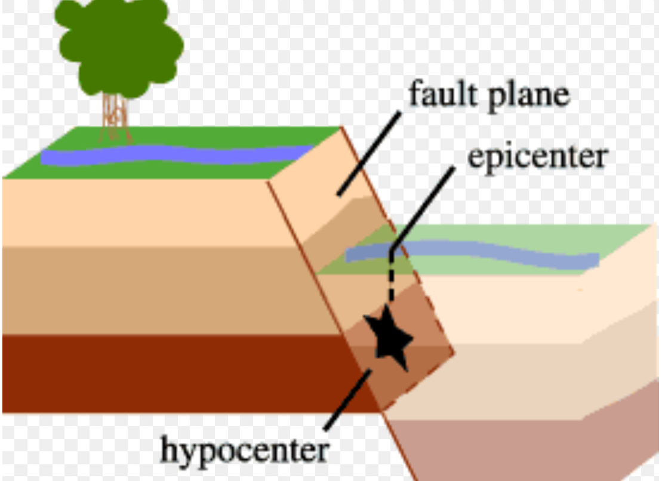
Notes:
The epicentre is not the centre. The earthquake occurs below ground and it refers to the nearest point on the surface to the centre (epi means around)

Slide 5
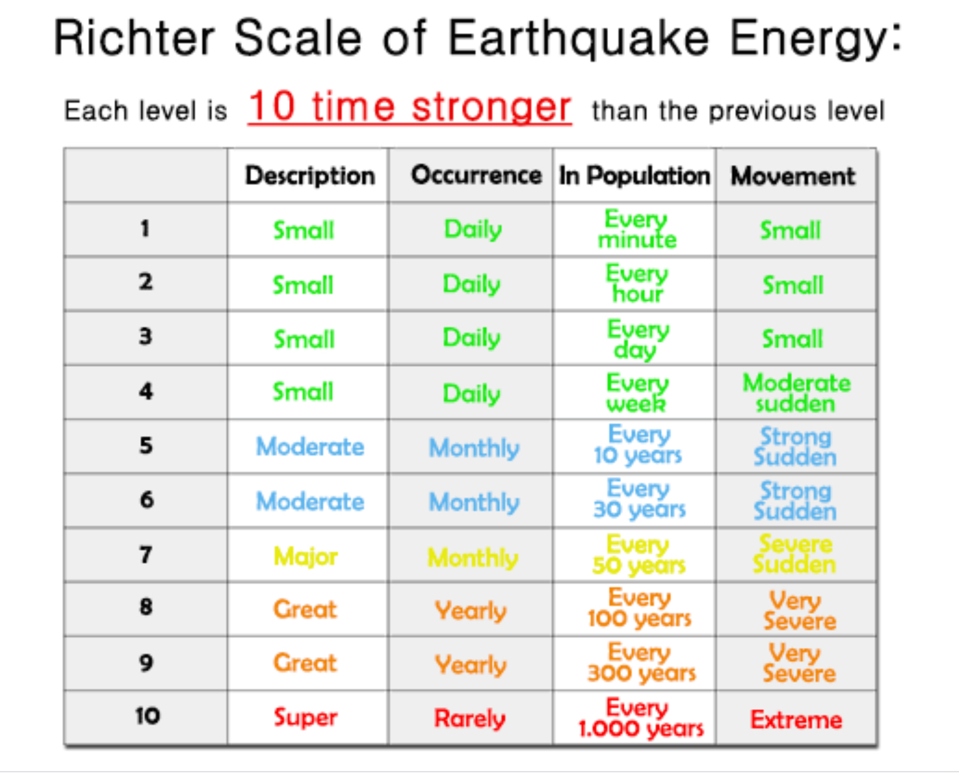
Notes:
The Richter scale is logarithmic.

Slide 6
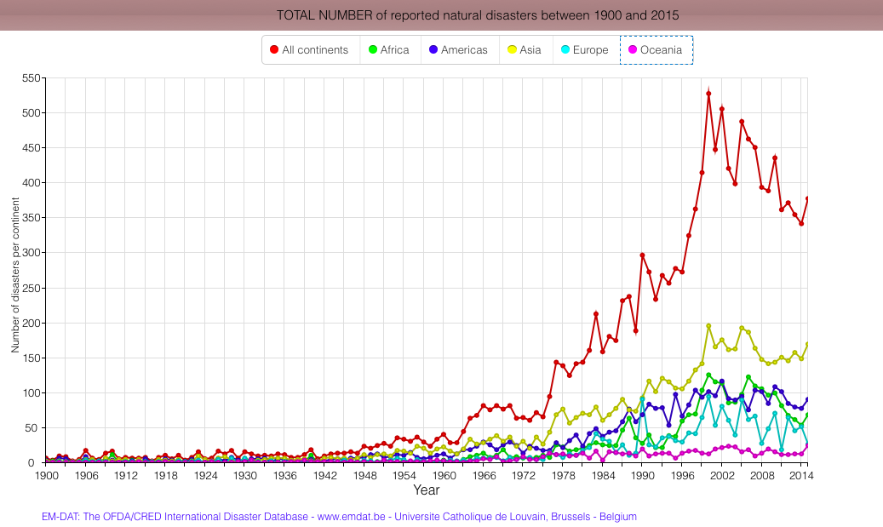
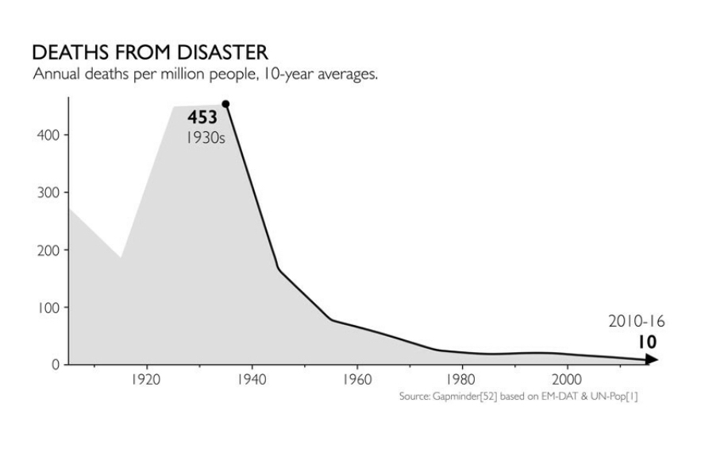
Disaster frequency
7
udden-impact
Gradual-onset
Notes:
The frequency and impact of disasters are increasing. Paradoxically the deaths from disasters are going down. What is probably happening is that climate change, migration and rapid urbanisation concentrate people, usually poor people, in the most vulnerable areas, and although worldwide the death toll has gone down, as Hans Rosling points out, it is concentrated in the poorest people and their communities.

Slide 7
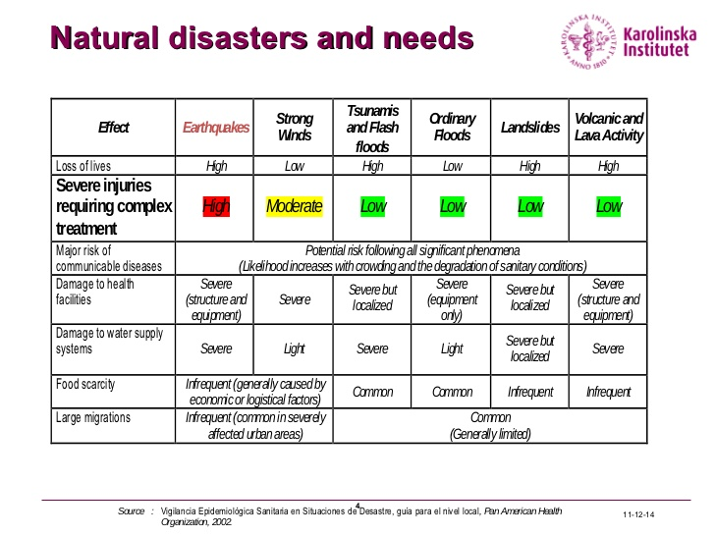
Notes:
Tsunamis kill far more than they injure as you cannot be severely injured and swim. So heed all the earnings and get away to higher ground.

Slide 8

Notes:
I do encourage you to read his book. It is in many ways quite uplifting as he graphically illustrates the improvements in health over the last century but also points out where the next big crises are likely to arise.

Slide 9
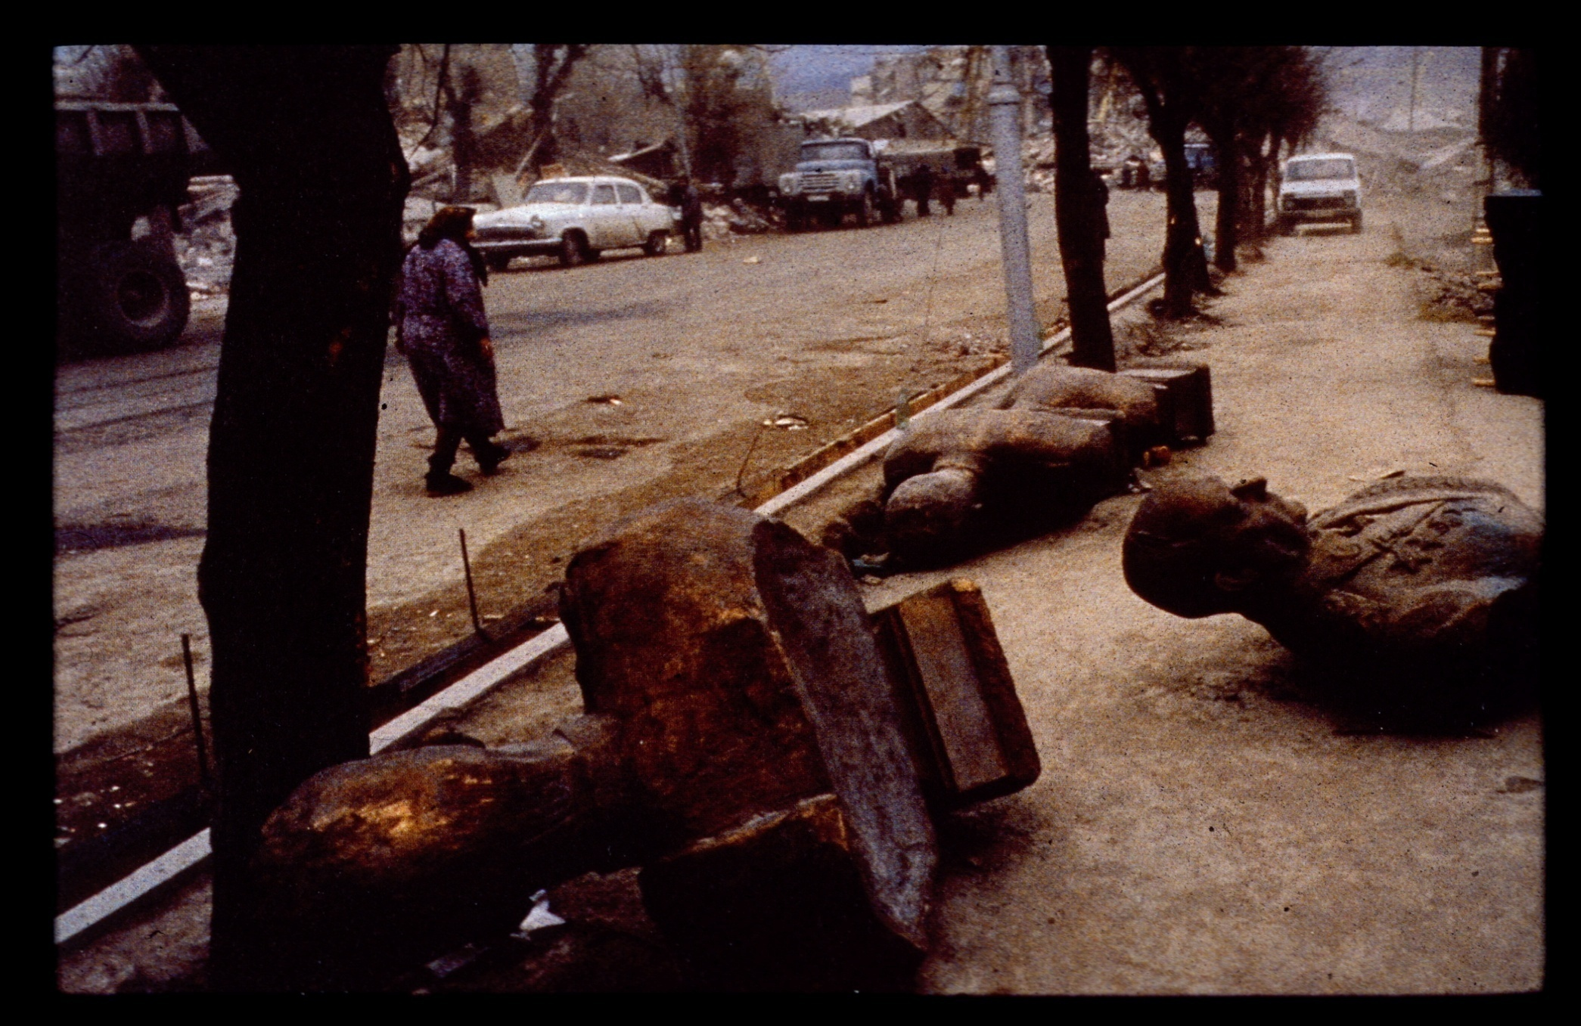
Armenian Earthquake
Redmond BMJ. 1989 September 2; 299(6699): 611–612.
Prof A D Redmond
Notes:
My first earthquake was over 30 years ago in Armenia.

Slide 10
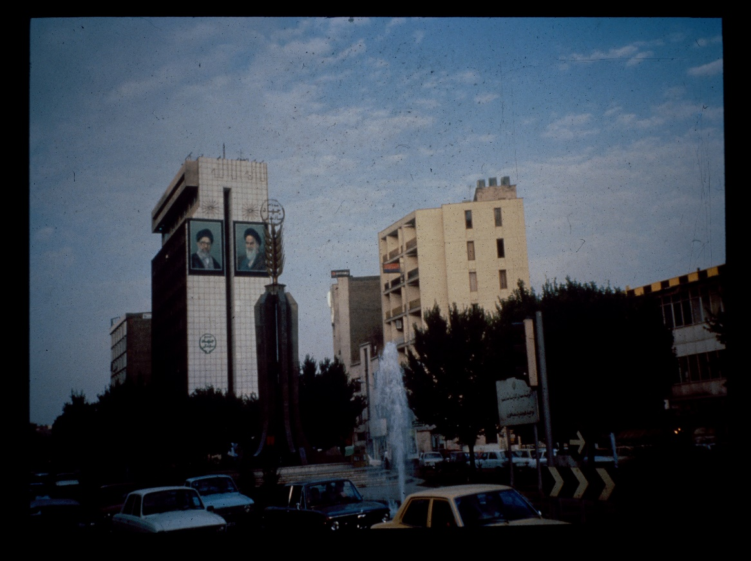
1990
Notes:
The two years later in Iran.

Slide 11
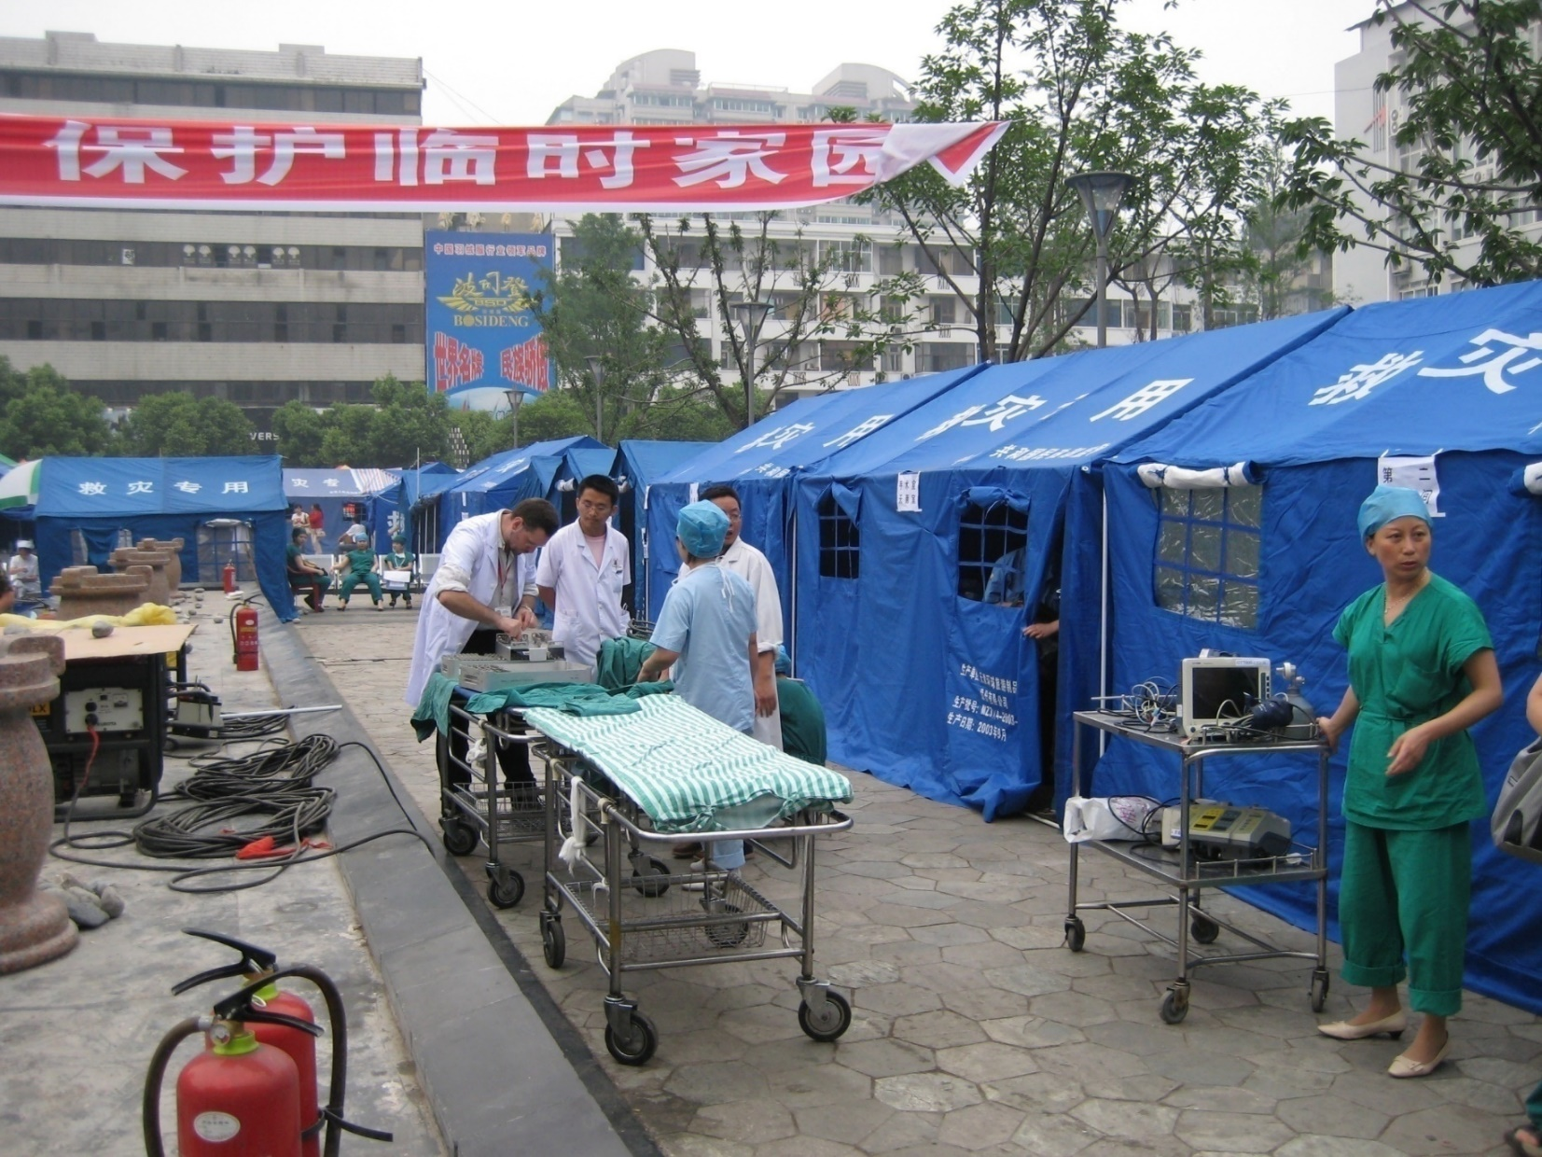
The emergency response can (should) merge into the development response
“The UK medical response to the Sichuan earthquake”
Redmond and Li
EMJ 2010
Notes:
I’ve also been to the Wenchuan earthquake in China where I was 13 floors up when a 6.4 aftershock struck. I followed the evacuation procedures and was fine.

Slide 12
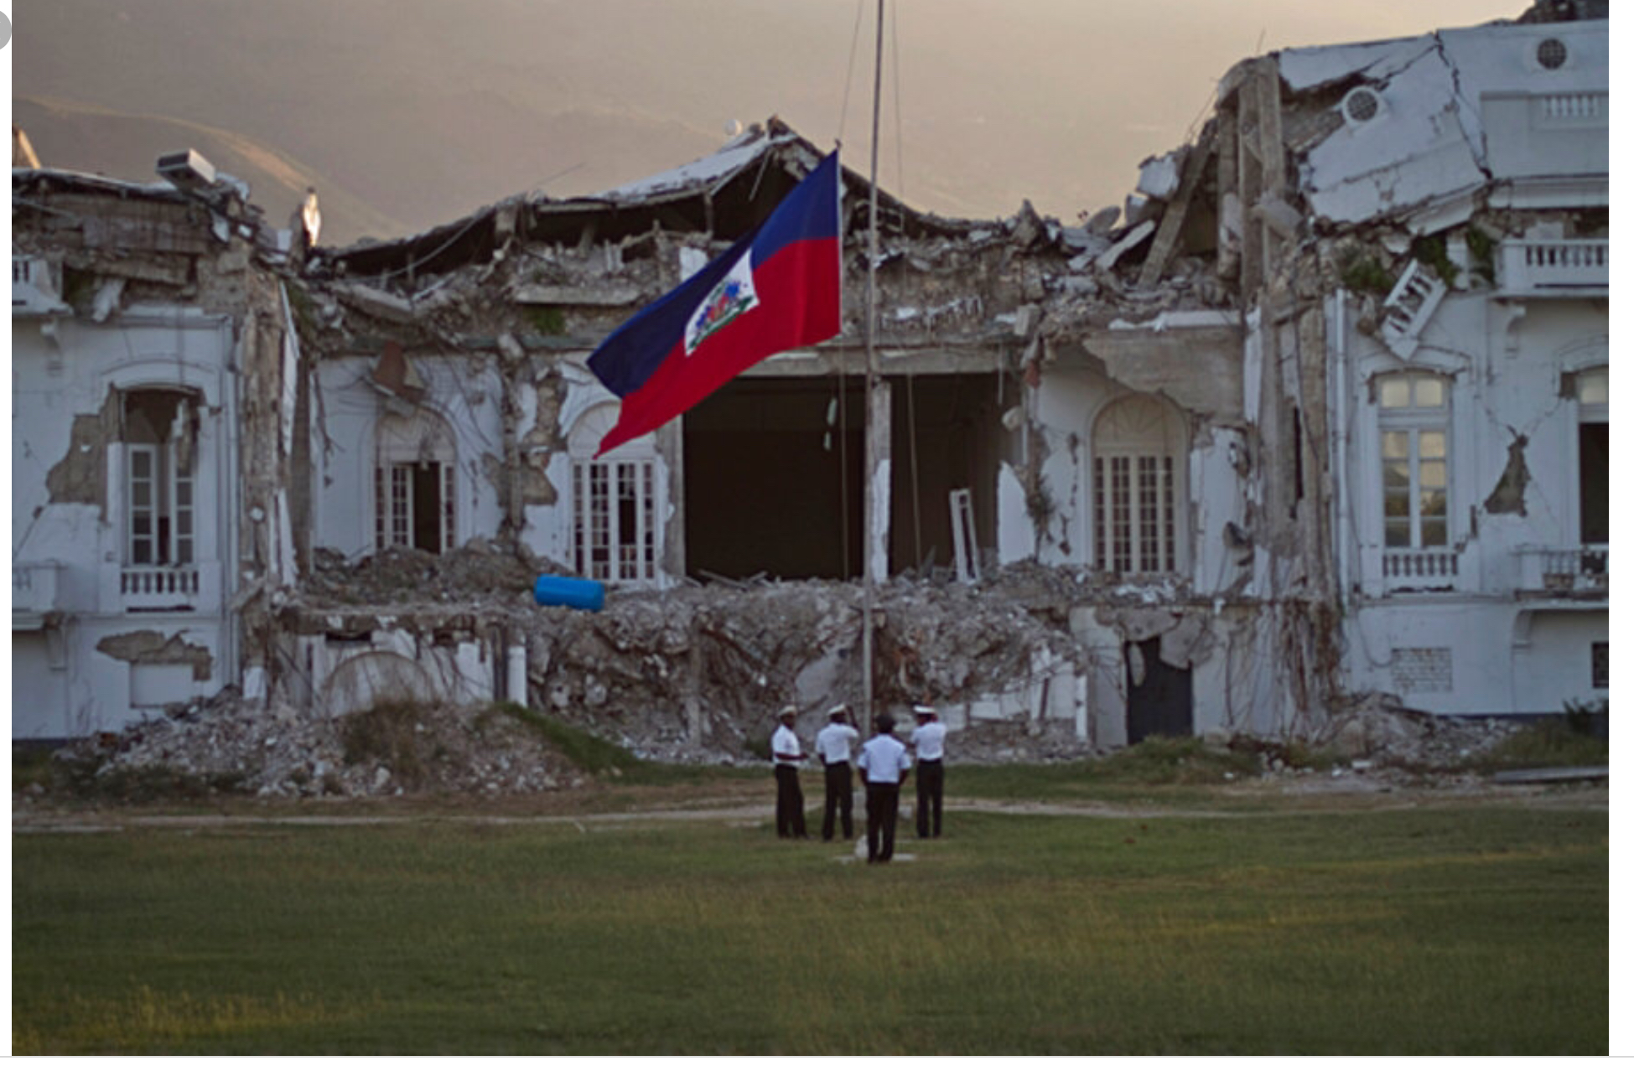
Notes:
I was at the earthquake in Haiti too. Again a powerful aftershock struck but I was outside in the open and not threated by falling debris. By the way the ground wont open up and swallow you like in the movies. Cracks in roads appear and cars crash and landslides occur.

Slide 13
Earthquakes don’t kill
Falling buildings kill
Lack of adequate medical care kills
Air traffic control failures kill
Traffic control failures kill

Slide 14
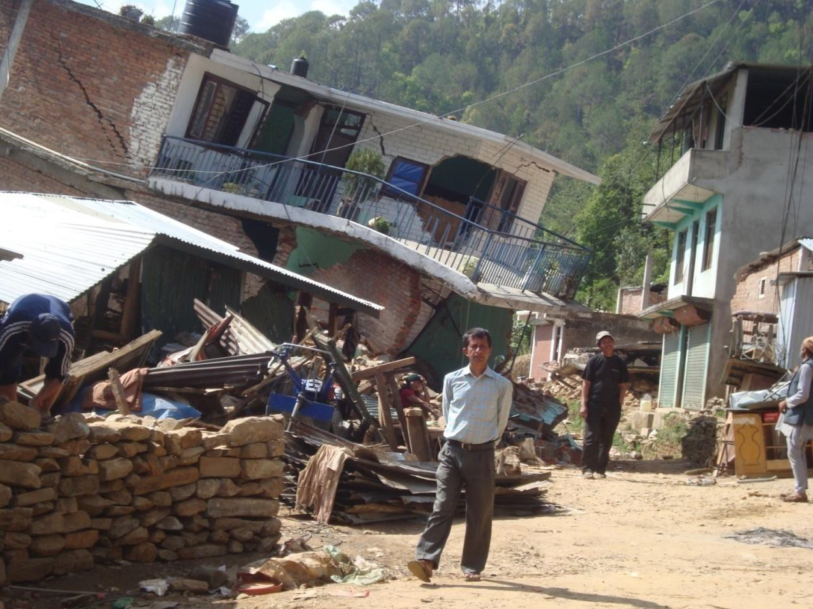
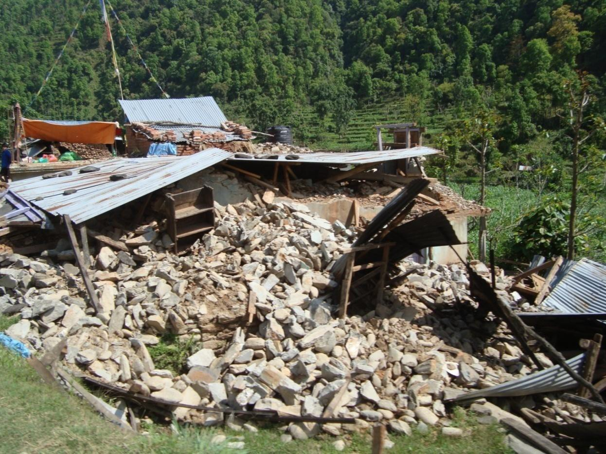
Earthquakes – risk factors for injury
16
Proximity to buildings
Position inside building
Notes:
Modern buildings – get into corner – drop – cover – hold on

Slide 15
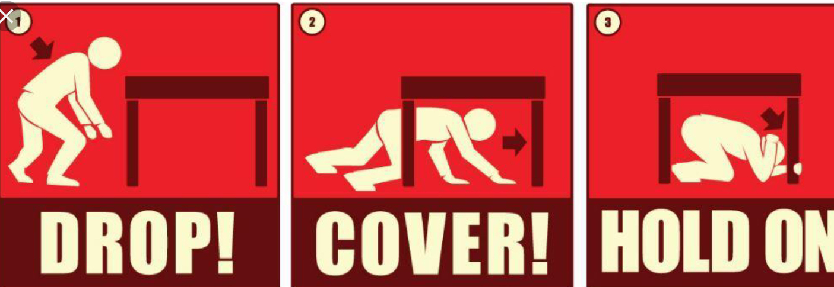

Slide 16
If you are indoors during an earthquake
DROP to the ground; take COVER by getting under a sturdy table or other piece of furniture; and HOLD ON until the shaking stops.
If there isn’t a table or desk near you, cover your face and head with your arms and crouch in an inside corner of the building.
Stay away from glass, windows, outside doors and walls, and anything that could fall, such as lighting fixtures or furniture.
Stay in bed if you are there when the earthquake strikes. Hold on and protect your head with a pillow, unless you are under a heavy light fixture that could fall. In that case, move to the nearest safe place.

Slide 17
If you are indoors during an earthquake
Do not use a doorway except if you know it is a strongly supported, load-bearing doorway and it is close to you. Many inside doorways are lightly constructed and do not offer protection.
Stay inside until the shaking stops and it is safe to go outside. Do not exit a building during the shaking. Research has shown that most injuries occur when people inside buildings attempt to move to a different location inside the building or try to leave.
DO NOT use the elevators.Be aware that the electricity may go out or the sprinkler systems or fire alarms may turn on.

Slide 18
If outside
Stay there.
Move away from buildings, streetlights, and utility wires.
Once in the open, stay there until the shaking stops.
The greatest danger exists directly outside buildings, at exits and alongside exterior walls.

Slide 19
In a vehicle
Stop as quickly as safety permits and stay in the vehicle.
Avoid stopping near or under buildings, trees, overpasses, and utility wires.
Proceed cautiously once the earthquake has stopped.
Avoid roads, bridges, or ramps that might have been damaged by the earthquake.

Slide 20
Trapped in rubble
Do not light a match.
Do not move around or kick up dust.
Cover your mouth with a handkerchief or clothing.
Tap on a pipe or wall so rescuers can locate you.
Use a whistle if one is available.
Shout only as a last resort. Shouting can cause you to inhale dangerous amounts of dust.

Slide 21
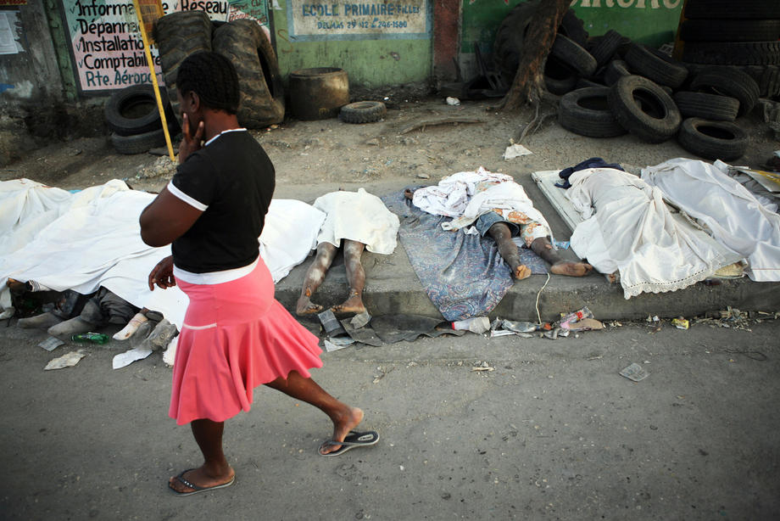
The Fear of the Unburied Dead
Notes:
The unburied dead are very distressing but will pose no risk to the living if they died during a sudden onset disaster. It seems counterintuitive but it’s true. Dead bodies are only a risk to the living when they died from an infection that will live on after death. This is limited to the viral haemorrhagic fevers such as Ebola and cholera

